Slide 1
RISC-V ISA Simulator

Slide 2
RISC-V Software Ecosystem
RISC-V Toolchain
This is used as RISC-V C and C++ cross-compiler.
It supports two build modes: a generic ELF/Newlib toolchain and a more sophisticated Linux-ELF/glibc toolchain.
Github repository link
GitHub - riscv-collab/riscv-gnu-toolchain: GNU toolchain for RISC-V, including GCC
Program
compile
Executable | execute | Output

Slide 3
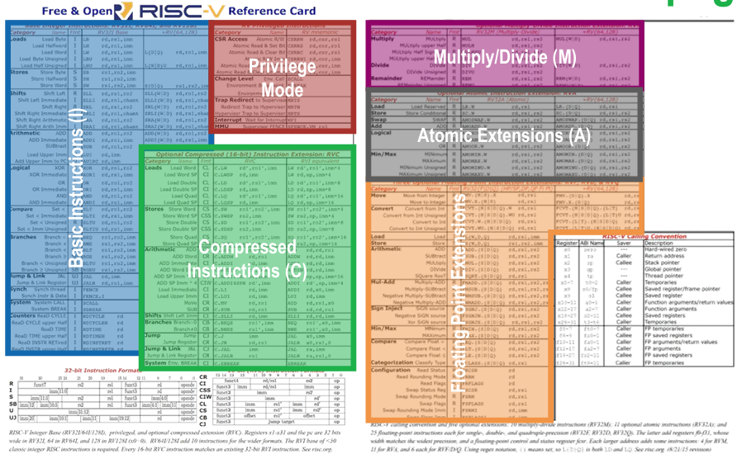
Reduced Instruction Set: all in one page

Slide 4
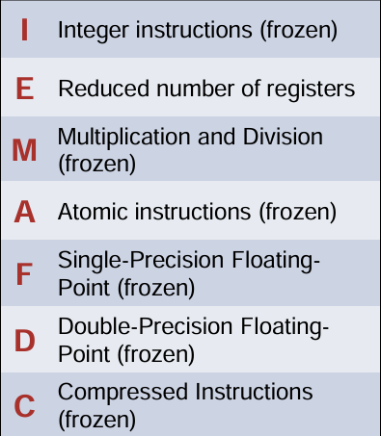
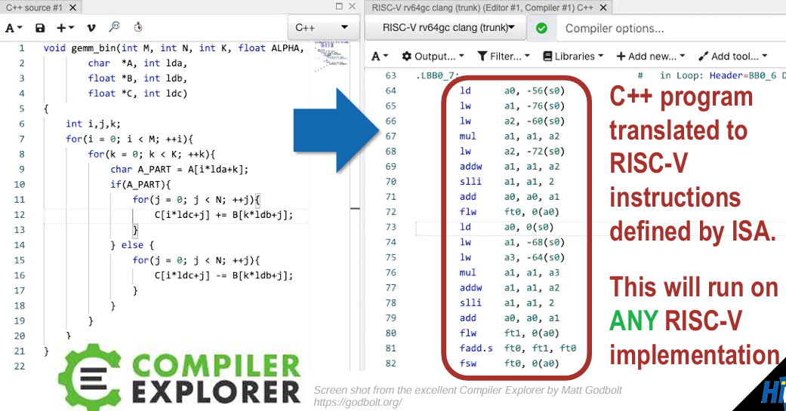
RISC-V ISA is divided into extensions
ISA defines the instructions that processor uses

Slide 5
Spike
Spike is the golden reference functional RISC-V ISA C software simulator.
Multiple ISAs: RV32IMAFDQCV extensions
Privileged Spec modes (v1.11)
Single-step debugging with support for viewing memory/register contents
Highly extensible

Slide 6
Proxy Kernel
The RISC-V Proxy Kernel, pk, is a lightweight application execution environment that can host statically-linked RISC-V ELF binaries.
It is designed to support tethered RISC-V implementations with limited I/O capability and thus handles I/O-related system calls by proxying them to a host computer.
This package also contains the Berkeley Boot Loader, bbl, which is a supervisor execution environment for tethered RISC-V systems.
It is designed to host the RISC-V Linux port.

Slide 7
Assembly Instructions
In assembly language, each statement (called an Instruction), executes exactly one of a short list of simple commands
Unlike in C (and most other High Level Languages), each line of assembly code contains at most 1 instruction.
Instructions are related to operations (=, +, -, *, /) in C

Slide 8
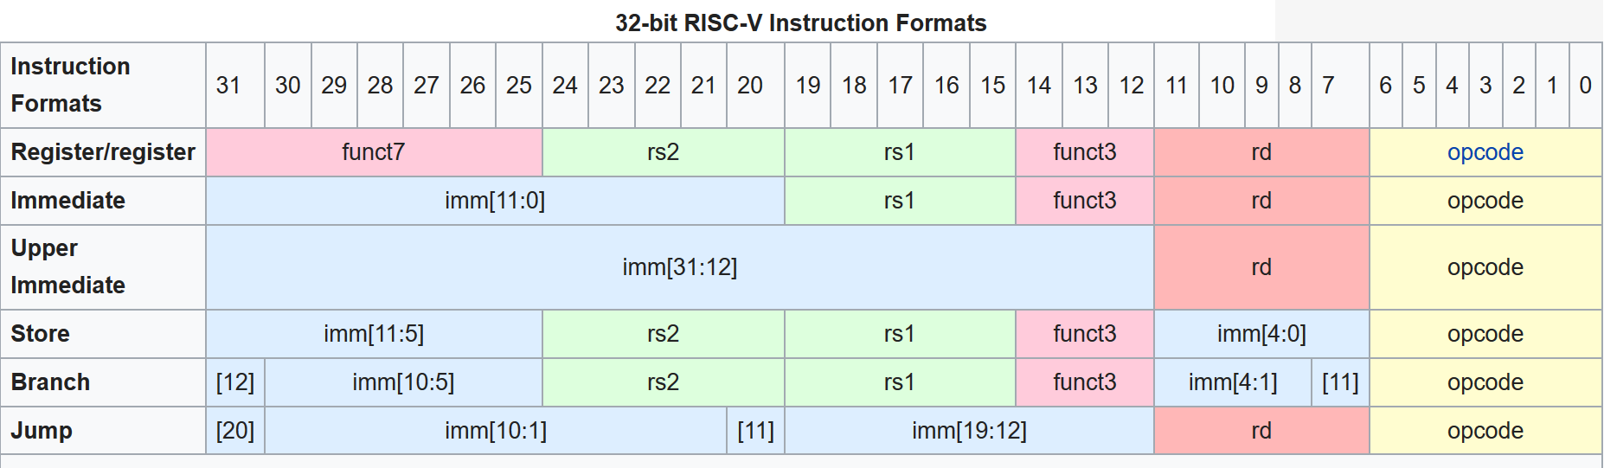
RISC-V ISA Instruction format
There are 6 different encoding format for instructions.

Slide 9
RISC-V Instructions
One operation per instruction, at most one instruction per line
Assembly instructions are related to C operations (=, +, -, *, /, &, |, etc.)
Must be, since C code decomposes into assembly!
A single line of C may break up into several lines of RISC-V
In Assembly Language, registers have no type, simply stores 0s and 1s; operation determines how register contents are treated

Slide 10
RISC-V Instructions
Instruction Syntax is rigid:
op dst, src1, src2
1 operator, 3 operands
op = operation name (“operator”)
dst = register getting result (“destination”)
src1 = first register for operation (“source 1”)
src2 = second register for operation (“source 2”)
Keep hardware simple via regularity

Slide 11
RISCV Instructions Example
Suppose a → s0,b → s1,c → s2,d → s3 and e → s4.
Convert the following C statement to RISCV:
a = (b + c) - (d + e);
add t1, s3, s4
add t2, s1, s2
sub s0, t2, t1
Ordering of instructions matters (must follow order of operations)
Utilize temporary registers

Slide 12
From Writing to Running
Compiler
Assembler
Linker
gcc -S
gcc -c
gcc -o
executable
program
sum.c
sum.s
sum.o
C source
files
assembly
files
sum
obj files
exists on disk
“It’s alive!”
When most people say “compile” they mean
the entire process:
compile + assemble + link
Executing
in
Memory
process

Slide 13
C variables vs. registers
In C (and most High Level Languages) variables declared first and given a type. E.g., int fahr, celsius; char a, b, c, d, e;
Each variable can ONLY represent a value of the type it was declared as (cannot mix and match int and char variables).
In Assembly Language, the registers have no data type
Operation determines how register contents are treated

Slide 14
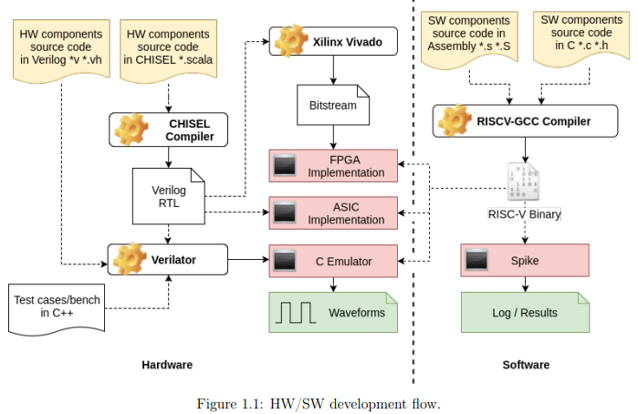
Software Flow
A compilation toolchain includes The COMPILER translates high-level source code to a lower-level representation
The ASSEMBLER is program that translates assembly language to machine language
The LINKER combines multiple files into a single executable

Slide 15
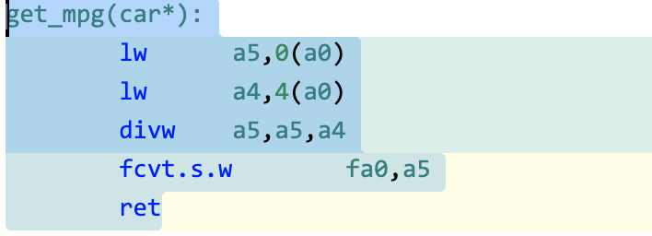

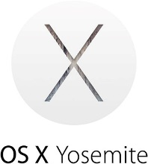

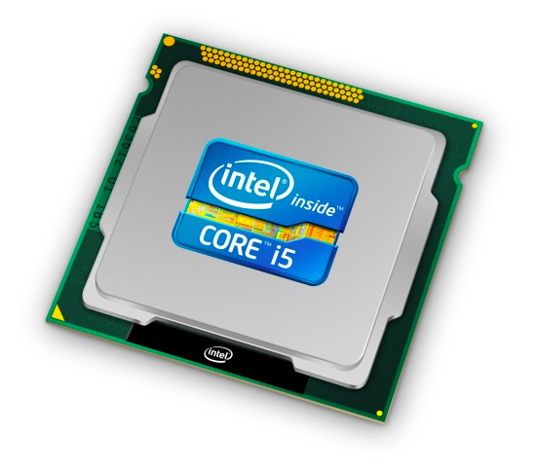
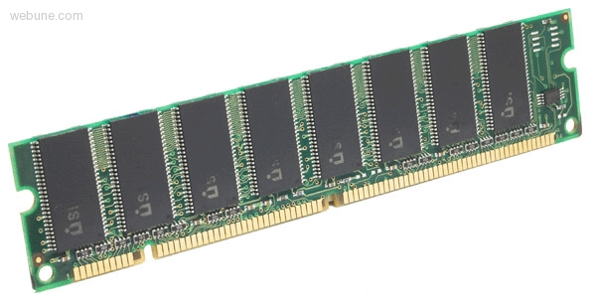
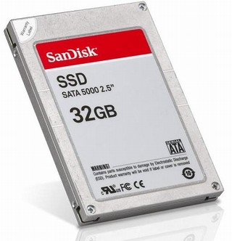
car *c = malloc(sizeof(car));
c->miles = 100;
float mpg = get_mpg(c);
free(c);
Memory & data
Arrays & structs
Integers & floats
RISC V assembly
Procedures & stacks
Executables
Memory & caches
Processor Pipeline
Performance
Parallelism
C:
Assembly language:
OS:
Machine code:
0111010000011000
100011010000010000000010
1000100111000010
110000011111101000011111
Computer system:

Slide 16
RISC-V Programming

Slide 17
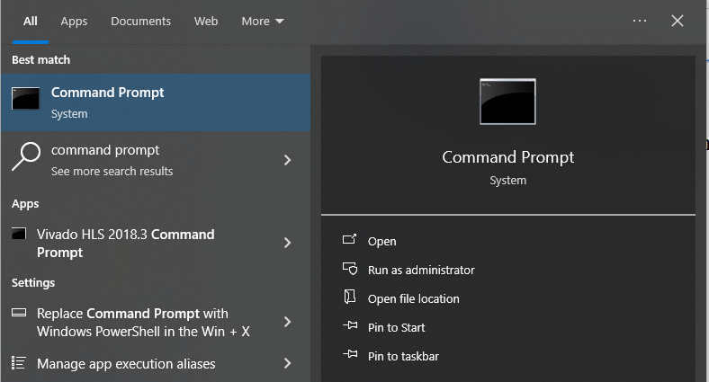
Launch the WSL software
Search for command prompt in windows and type the following command

Slide 18
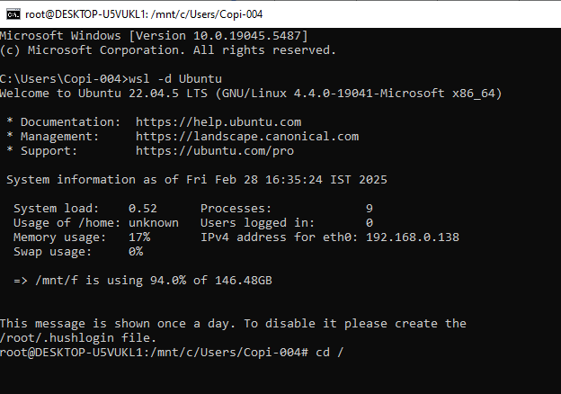
Initial Configuration
Launch command prompt using
wsl -d Ubuntu
To change from existing windows directory to the main working directory in Ubuntu

